Slide 1


Slide 2
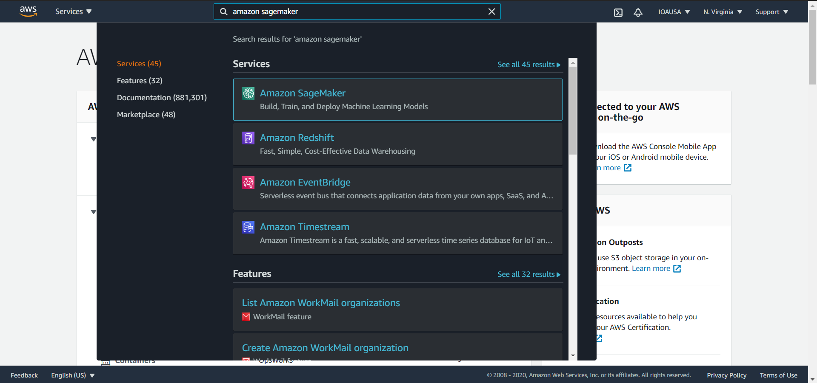
Search for Amazon SageMaker

Slide 3
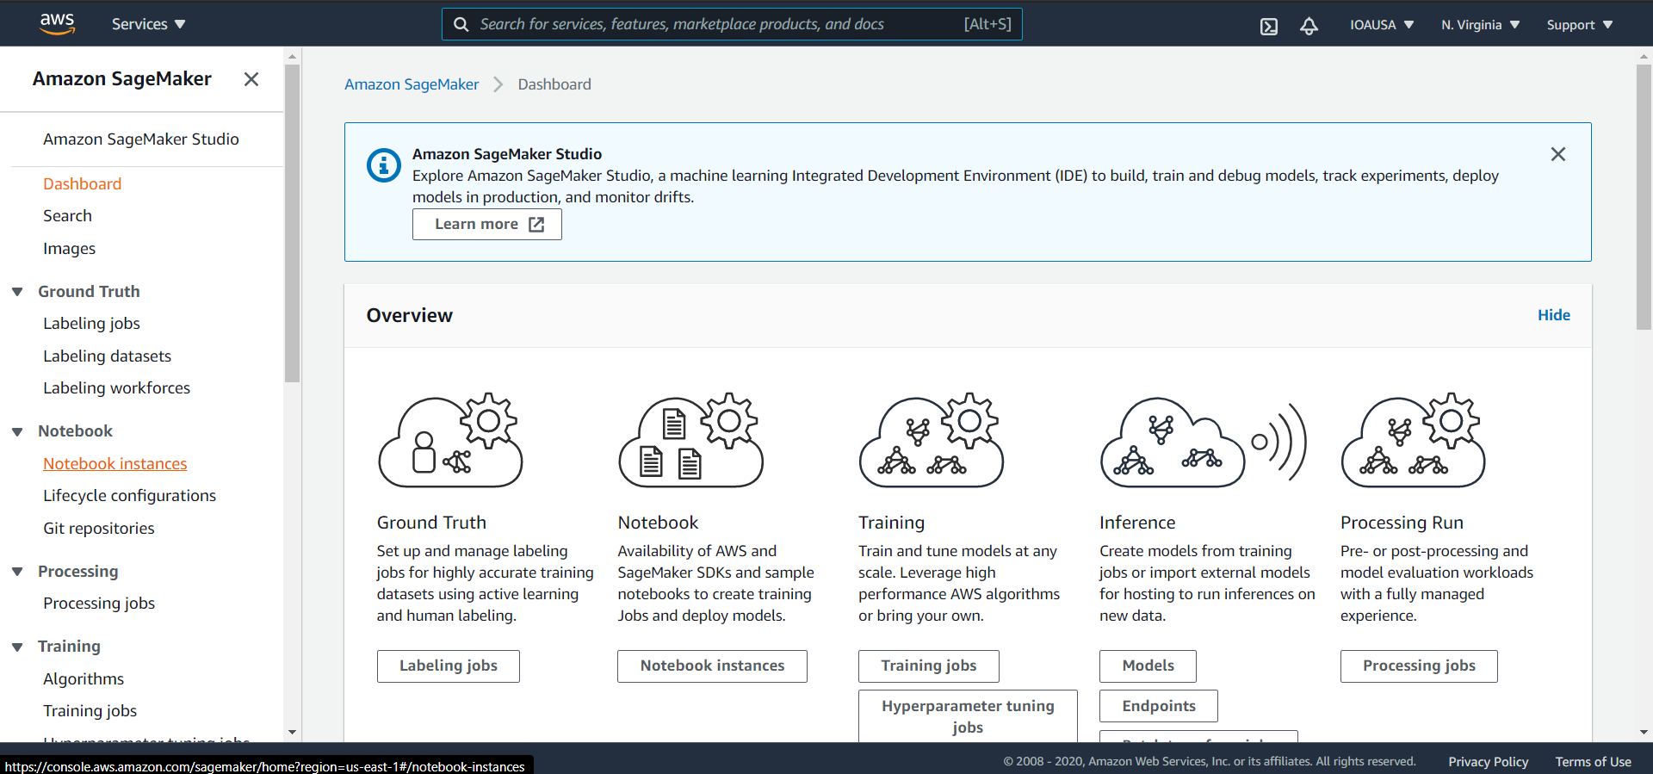
Amazon SageMaker Dashboard
Go to Notebook instances

Slide 4
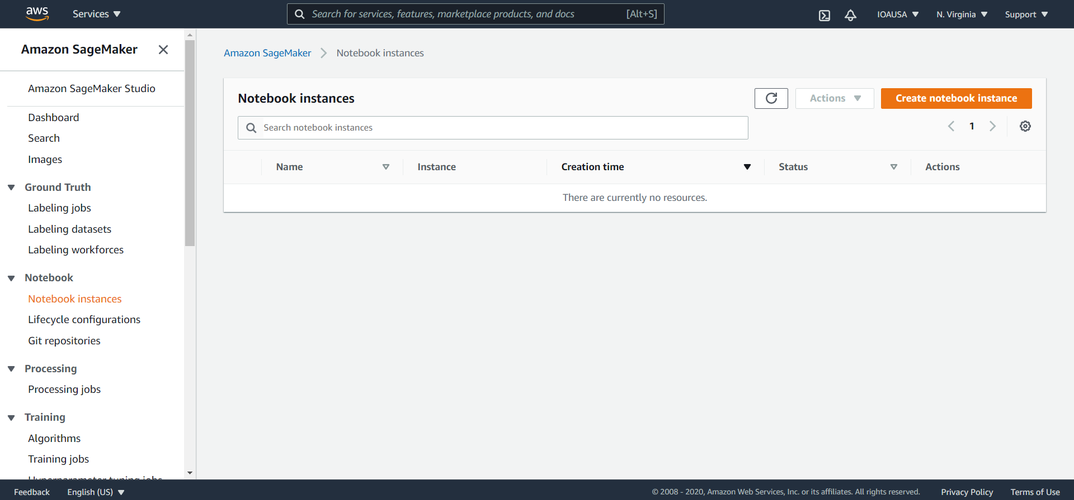
Create

Slide 5
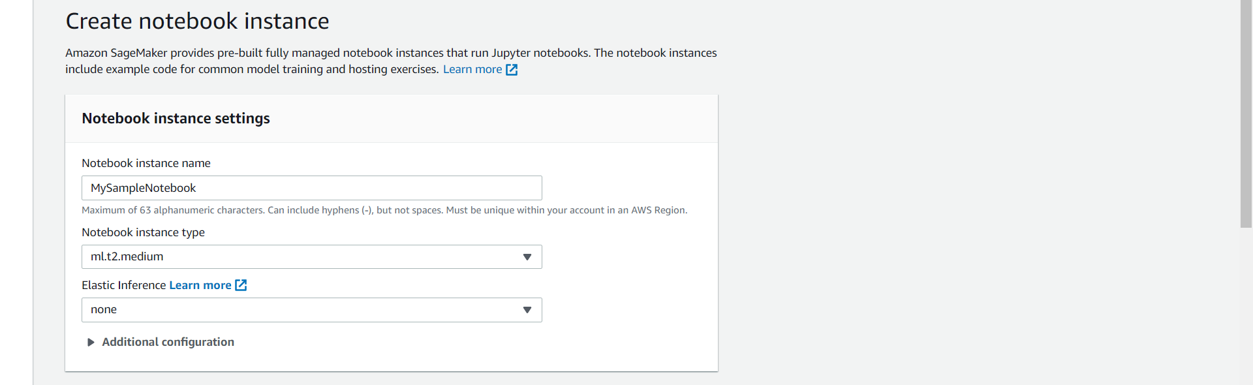
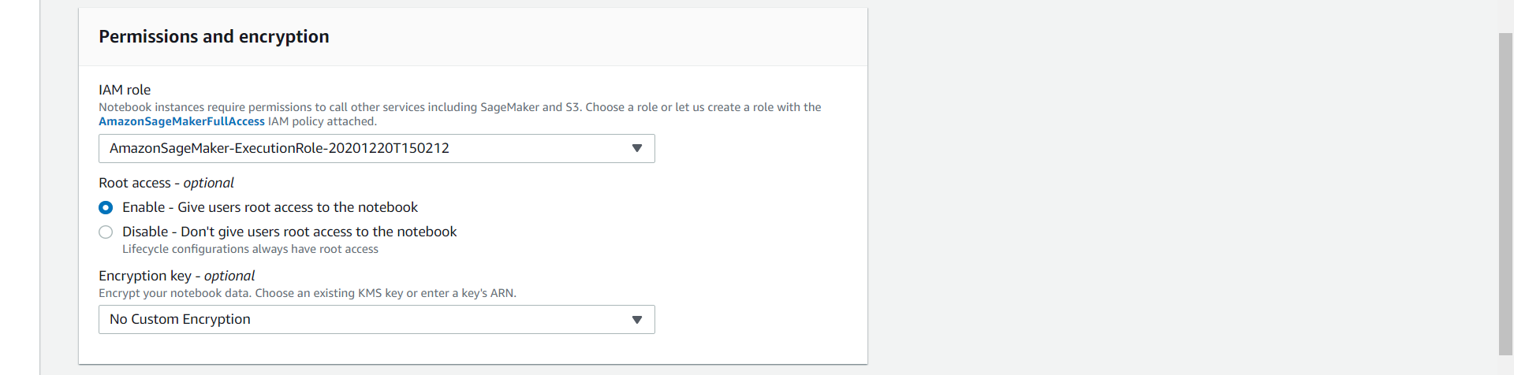
Instance Name
Instance Type
IAM role for SageMaker to access S3 buckets

Slide 6
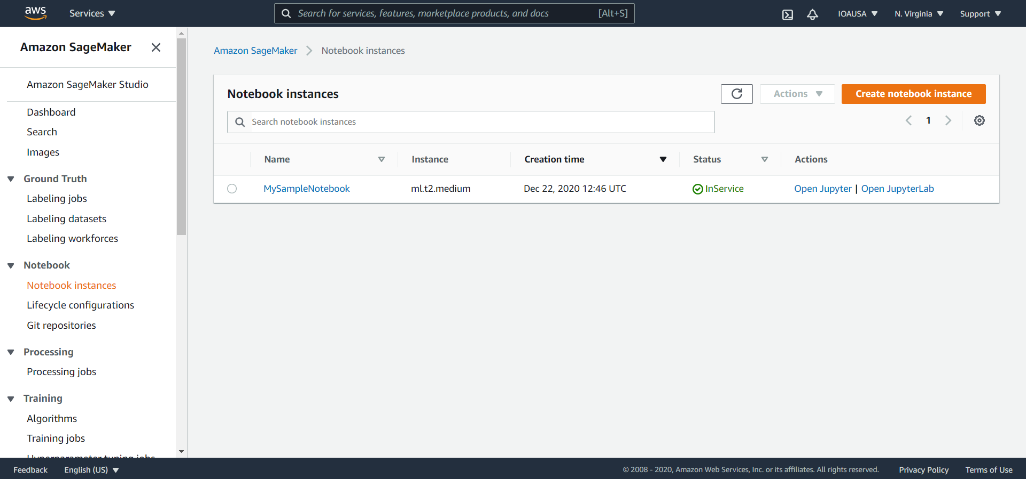

Slide 7
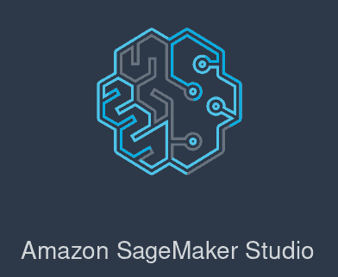


1
2
3

Slide 8
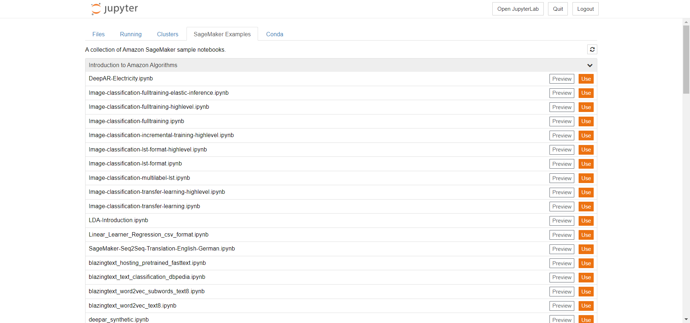
Jupyter Notebook

Slide 9
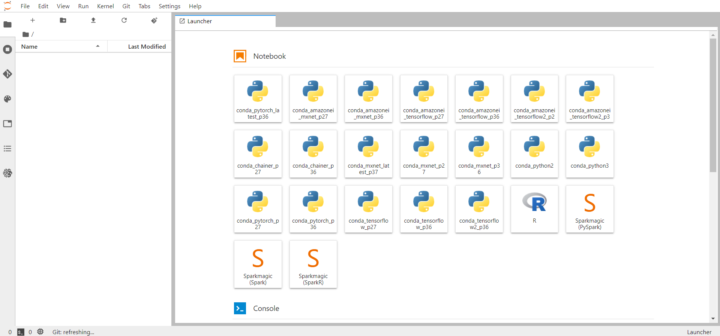
Jupyter Lab

Slide 10
PRICING
https://aws.amazon.com/sagemaker/pricing/

Slide 11
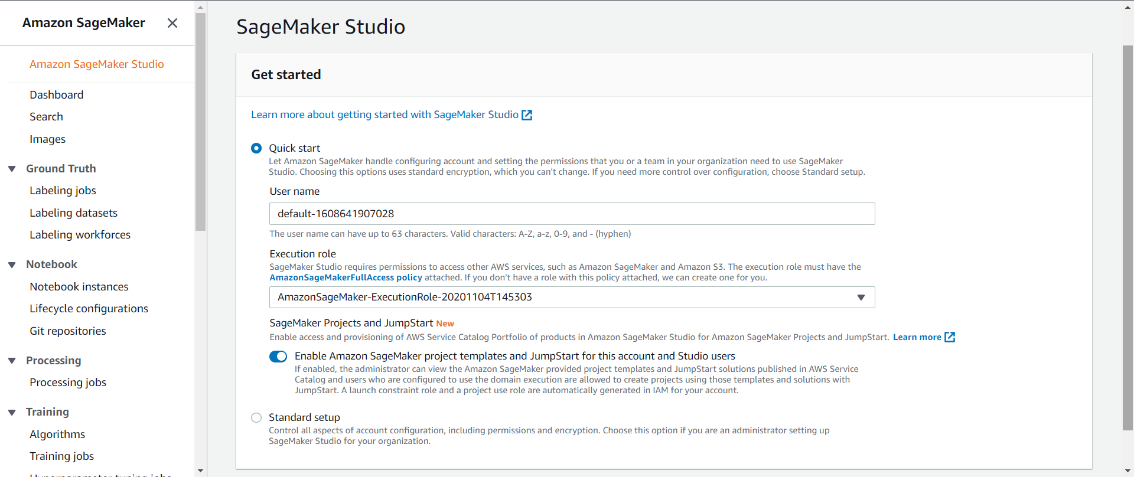
Create SageMaker Studio User

Slide 12
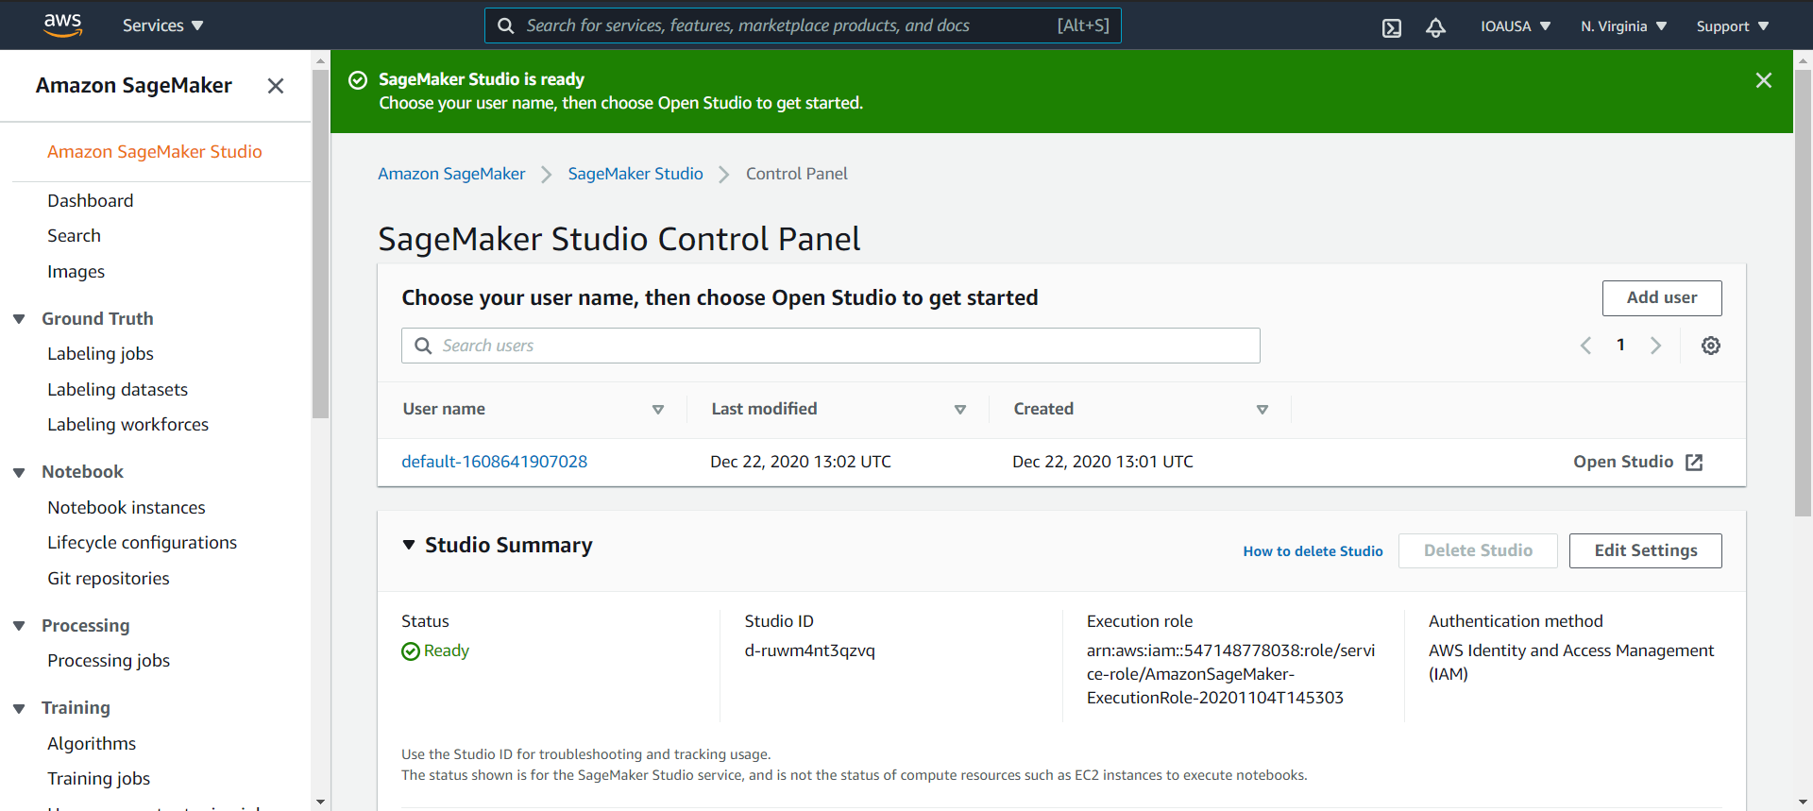
Open SageMaker Studio

Slide 13
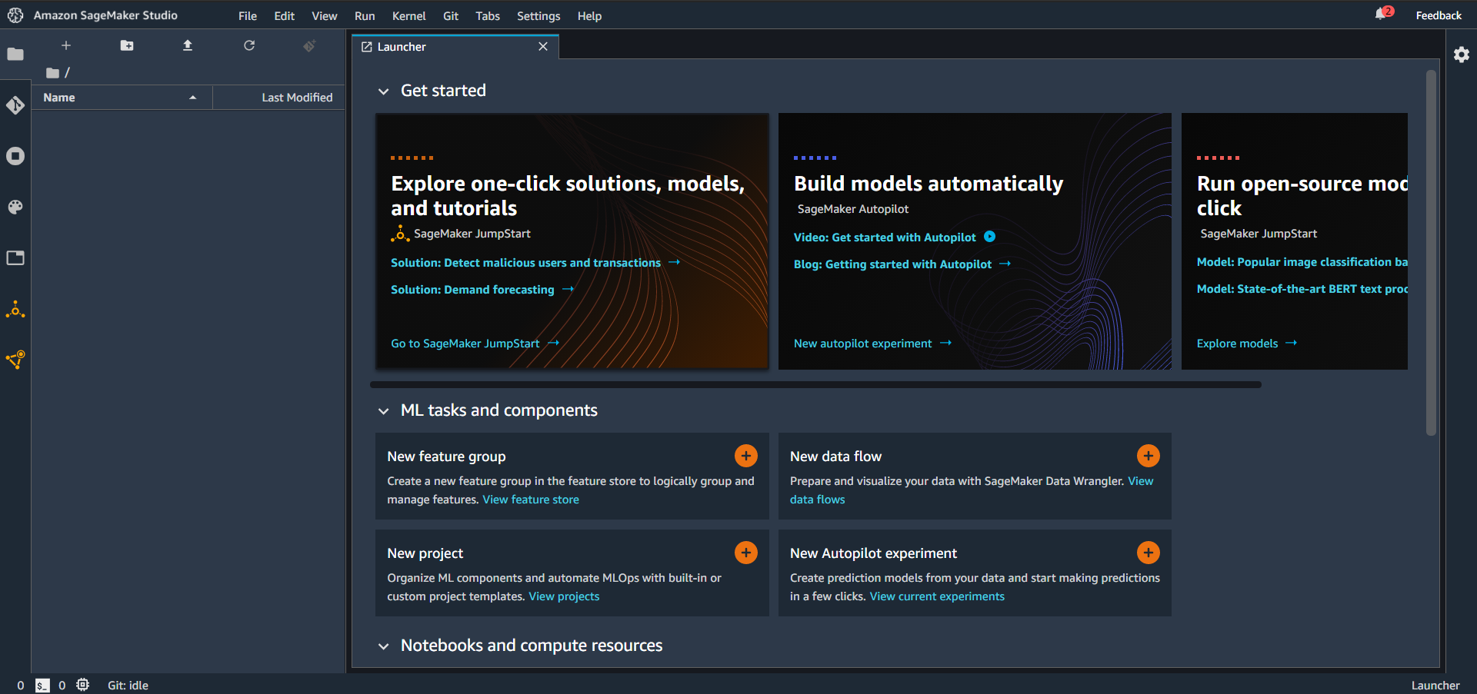
SageMaker Studio

Slide 14
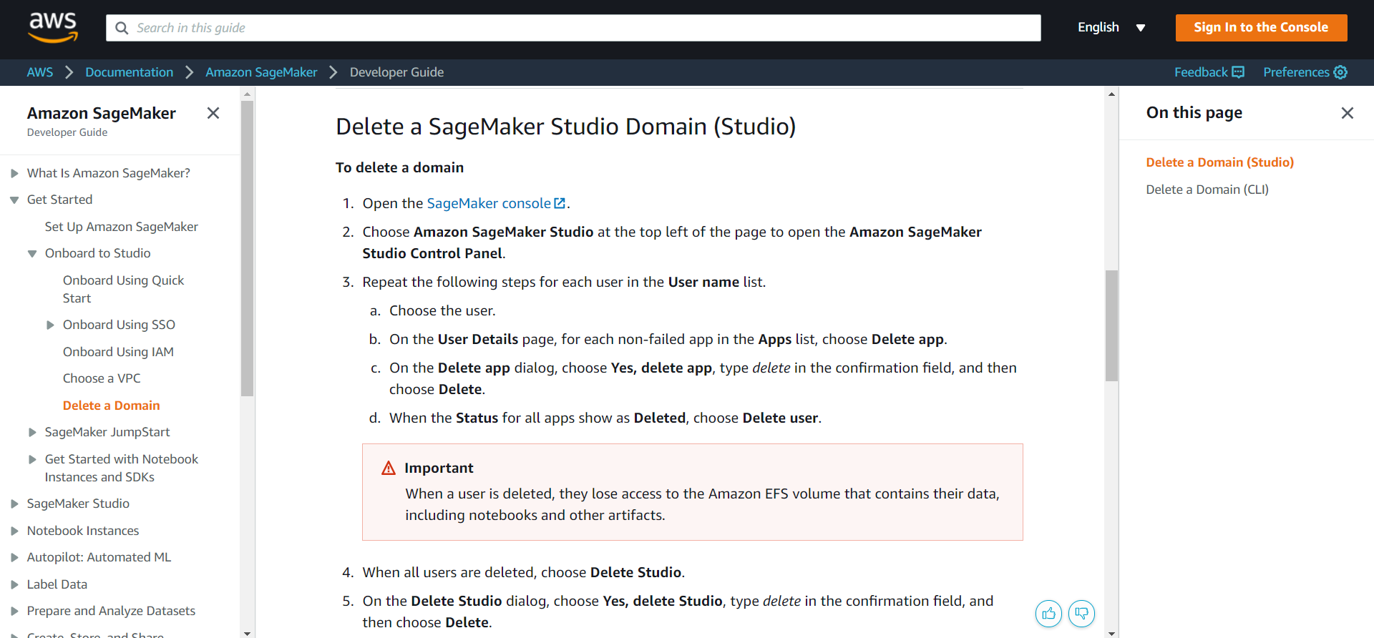
Delete SageMaker Studio Domain

Slide 15
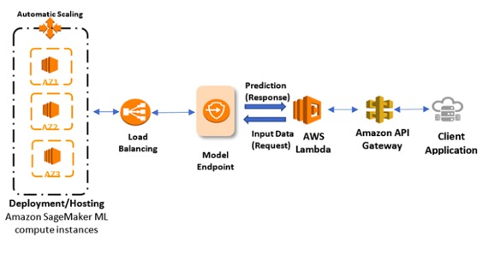
Within AWS
Setup for Outside AWS

Slide 16
AWS SageMaker examples
https://github.com/aws/amazon-sagemaker-examples

